Slide 1

Dynamic Adaptive of Ransomeware Defensive Profile Using Attack-Defense framework
Royal University of Phnom Penh
Faculty of Engineering
Student Pann Vichhka
Advior Na Sambathchatovong

Slide 2
Outline
Introduction
Objective
Literature review
Methodology
Result
Demo
Future work

Slide 3
Introduction
Ransomware vectors are nearly impossible to close
Phishing emails 70%
email attachments 54%
users visiting malicious and compromised website 41%
Most of ransomware gangs used MITRE ATT&CK framework as technique for build weaponize or kill chain
Ransomware-as-a-service innovations always change or cover their path based on cyber kill chain
Cyber security practitioner are often puzzled how to cope with ransomware attacks when it occurs or finds the potential risk willing occur

Slide 4
Objective
Build up an attack-defense framework by mapping MITRE ATT&CK Framework to NIST Cybersecurity Framework
To experiment defensive approach by identify ransomware gangs techniques based on MITRE ATT&CK Matrix and provide a set of guidelines
Build a ransomware defensive dynamic profile by using Attack-defense framework

Slide 5
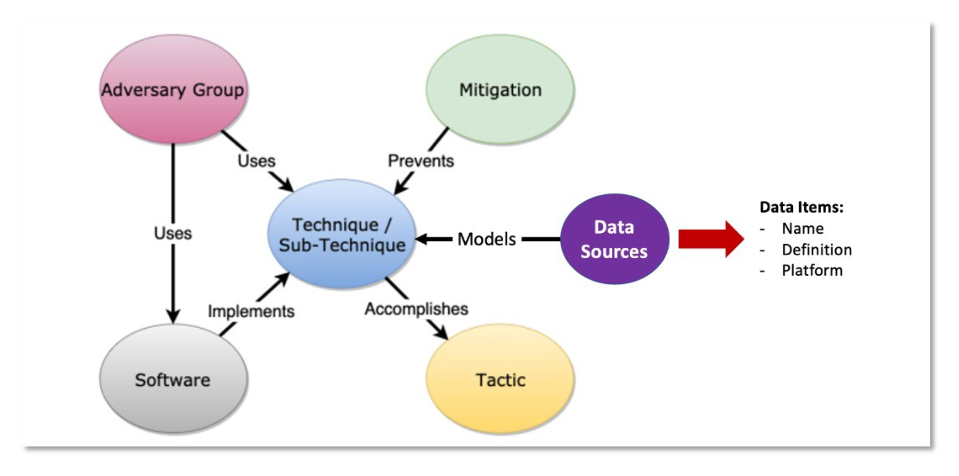
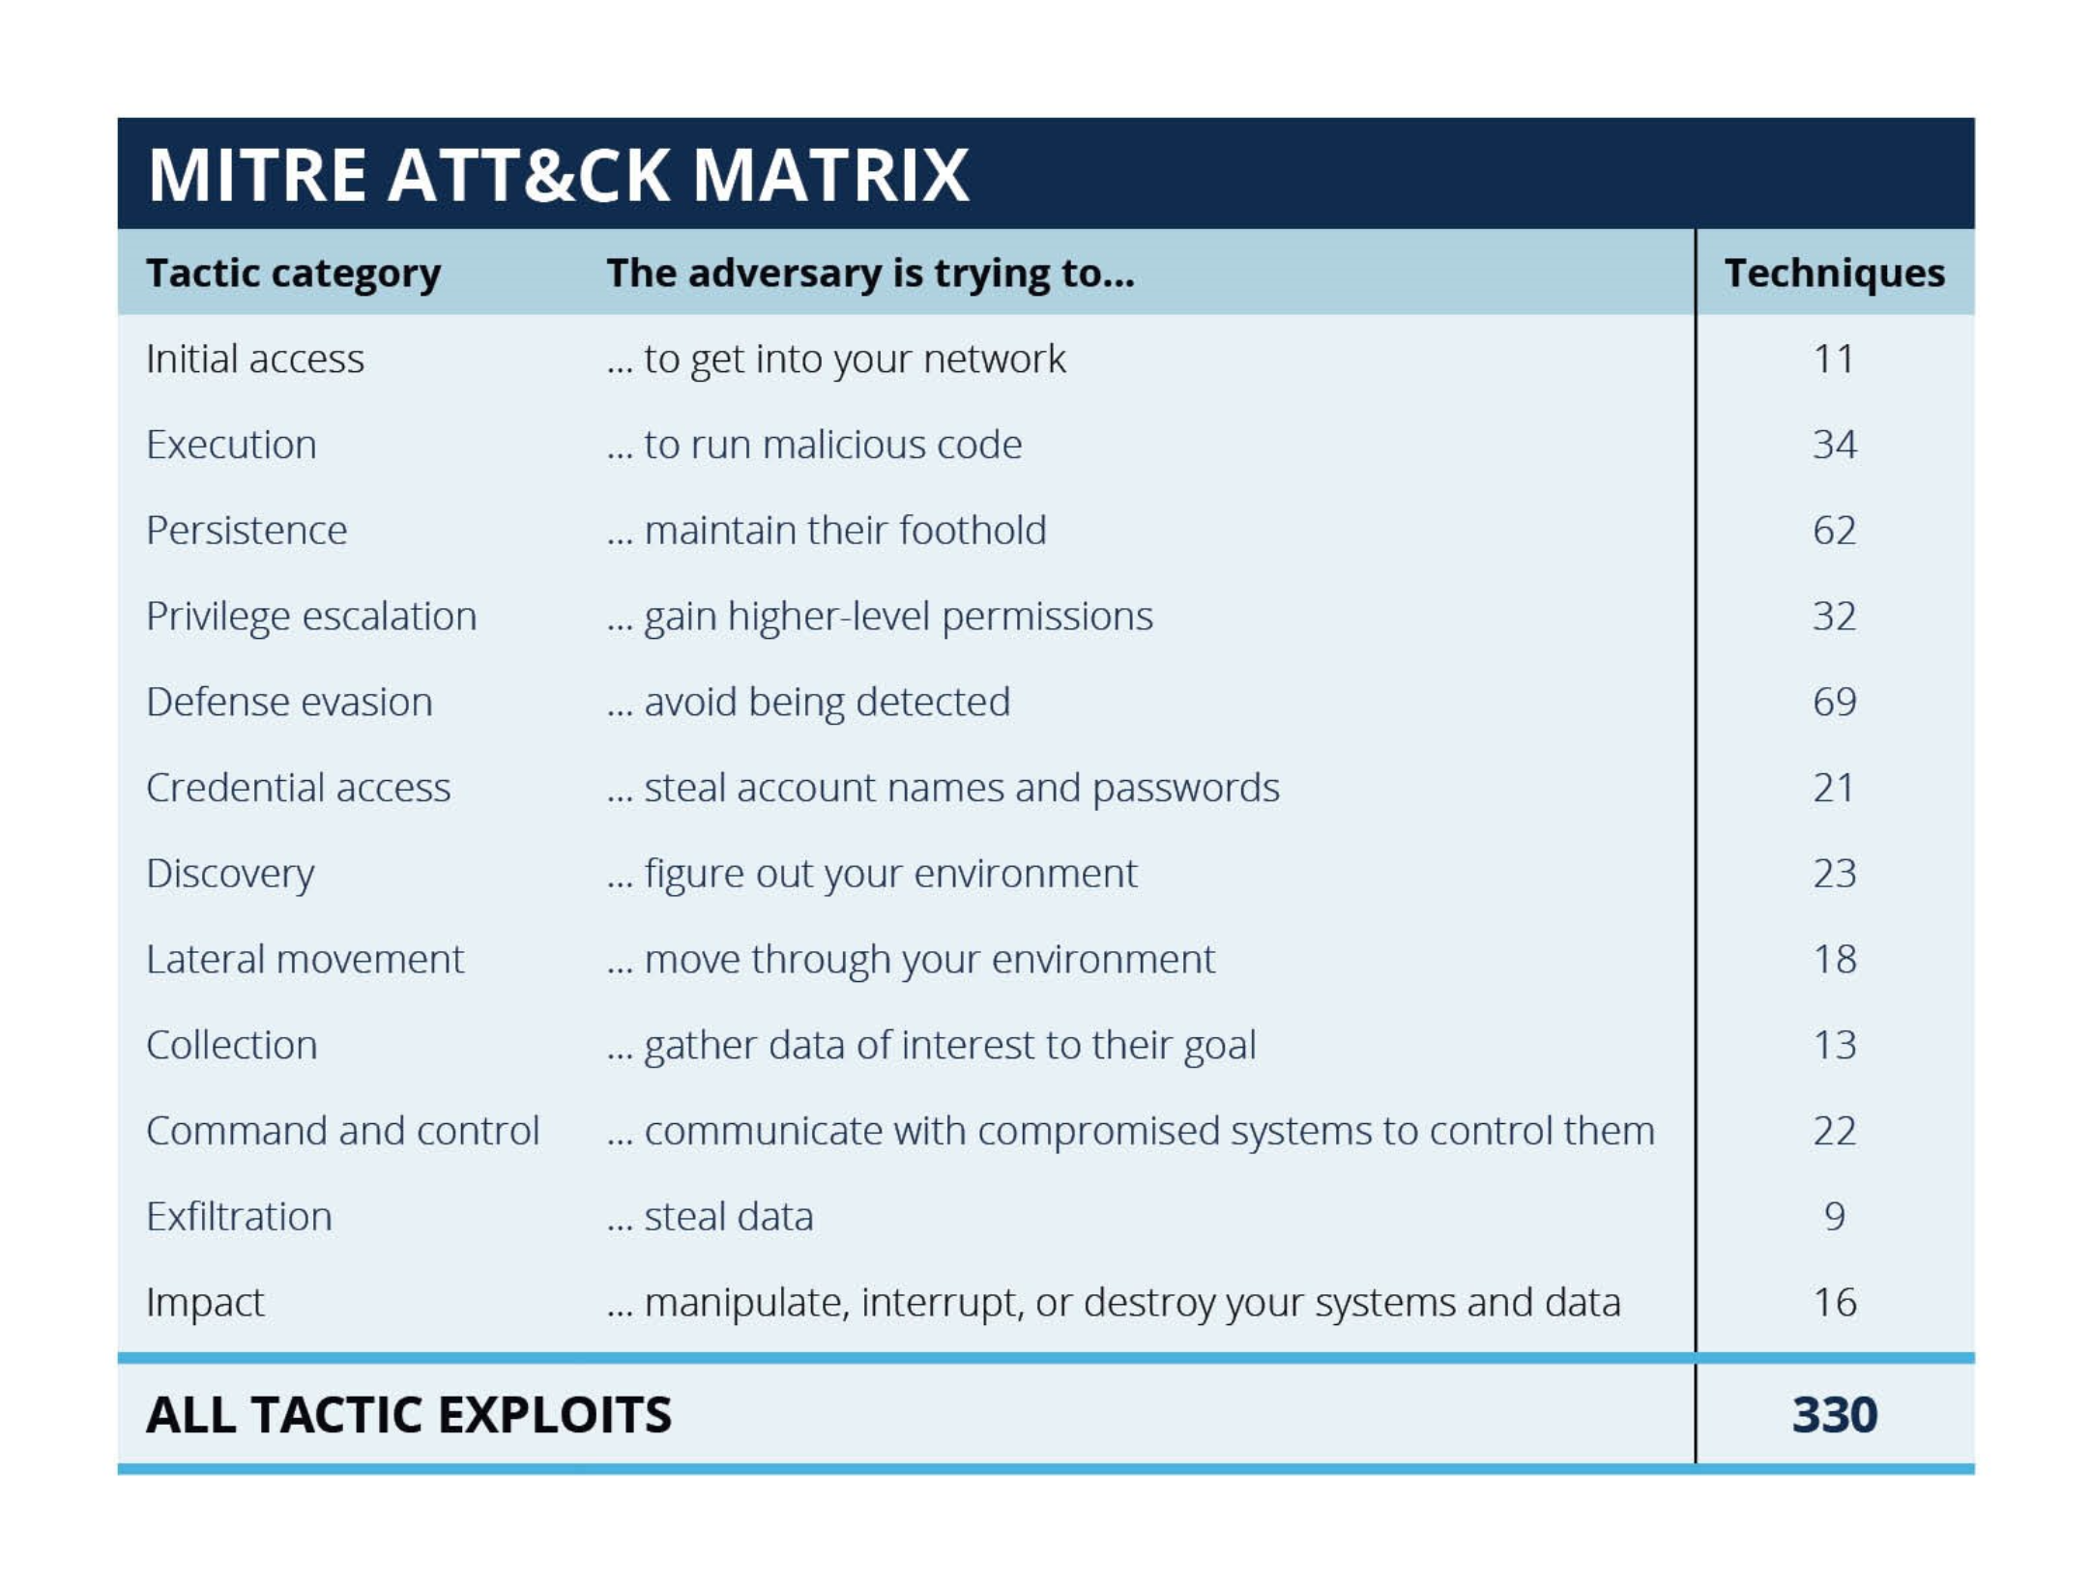
Literature Review
MITRE ATT&CK Framework
Post-compromise recognition and preventions
Technical used

Slide 6
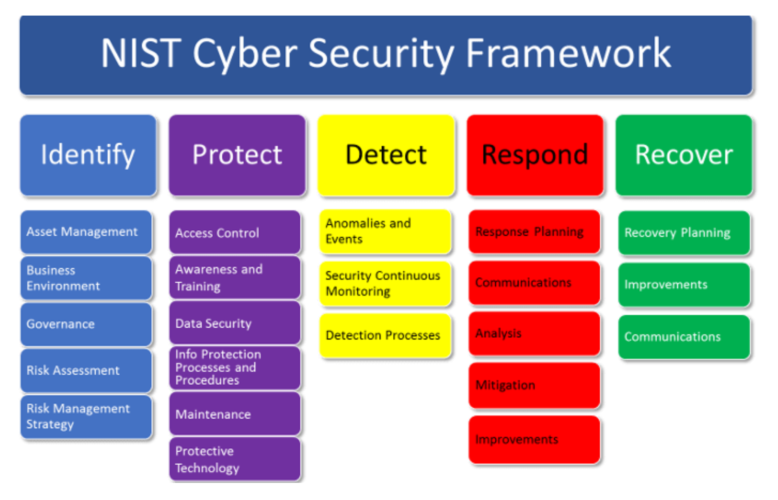
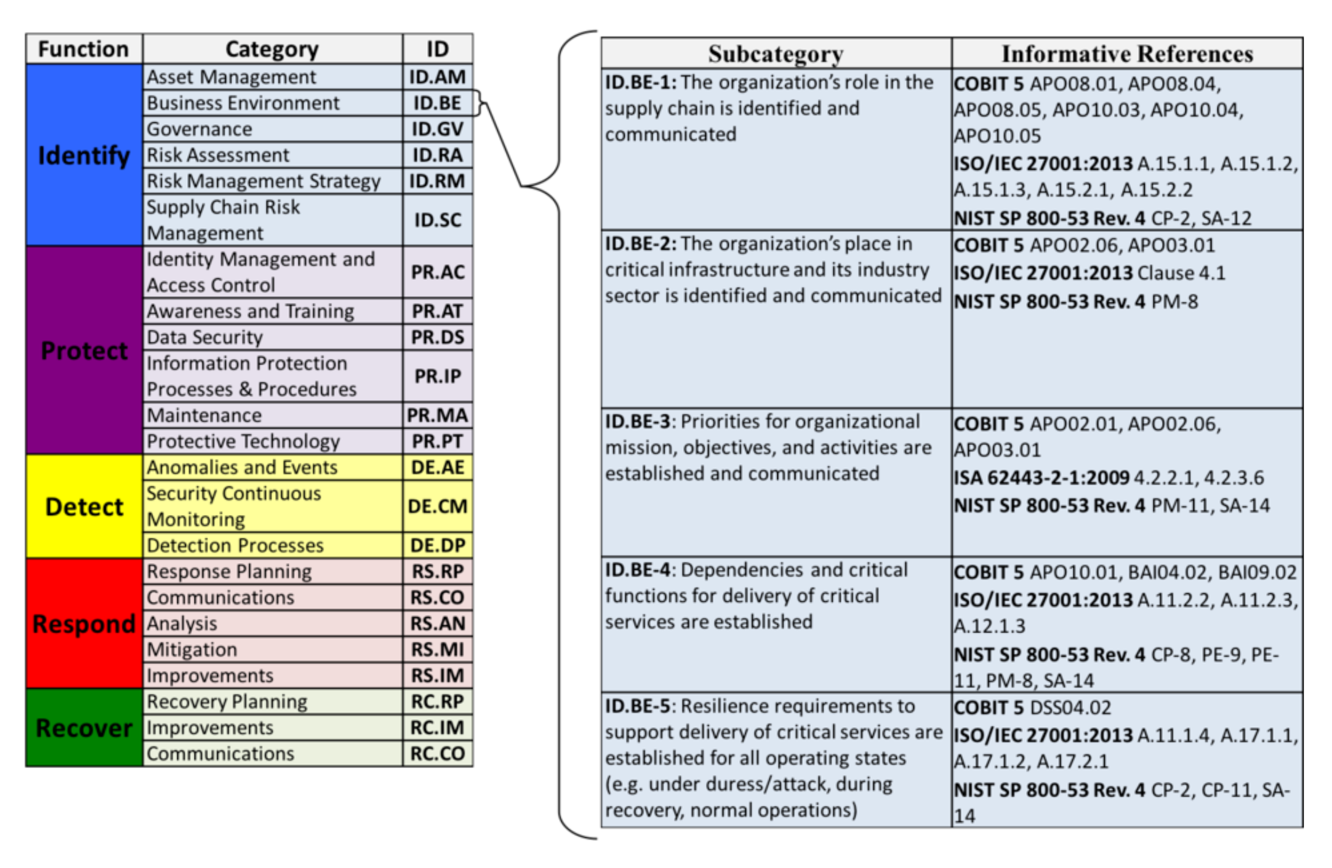
Literature Review
NIST Cybersecurity Framework
A set of cybersecurity best practices and recommendations
Simplifies the language of cybersecurity for everyone

Slide 7
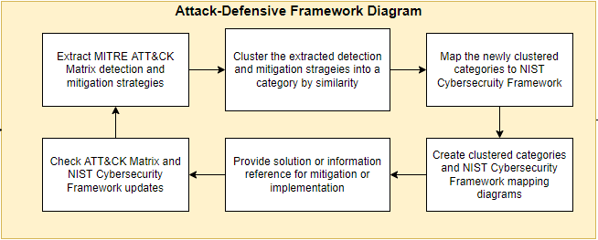
Methodology
From MITRE ATT&CK Matrix to NIST Cybersecurity Framework

Slide 8
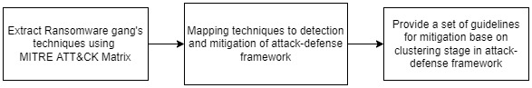
Methodology
Usage of attack-defense framework in build up a ransomware defensive profile

Slide 9
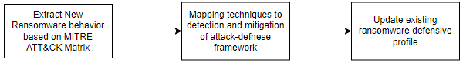
Methodology
Profile Enhancement lifecycle

Slide 10
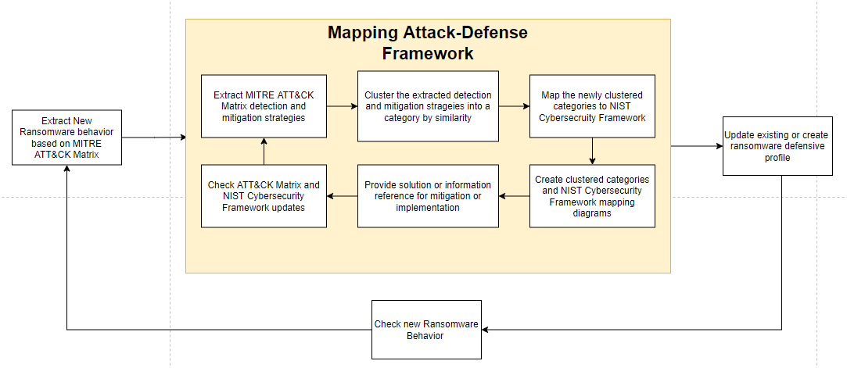
Result
Full diagram

Slide 11
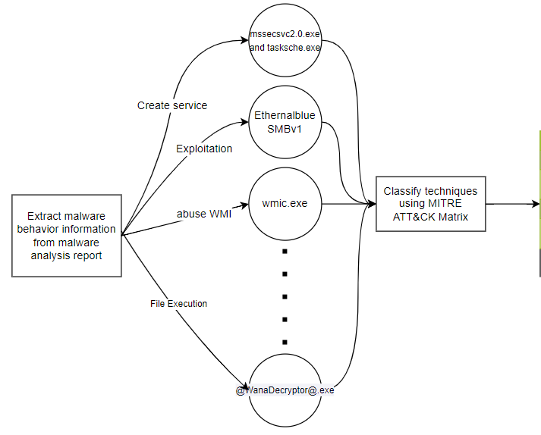
Demo

Slide 12
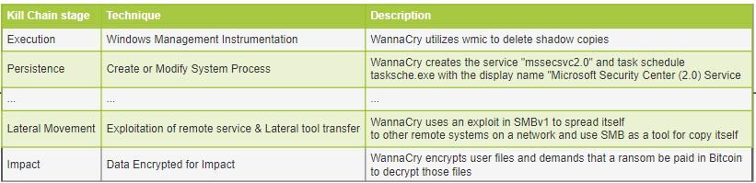
Demo

Slide 13
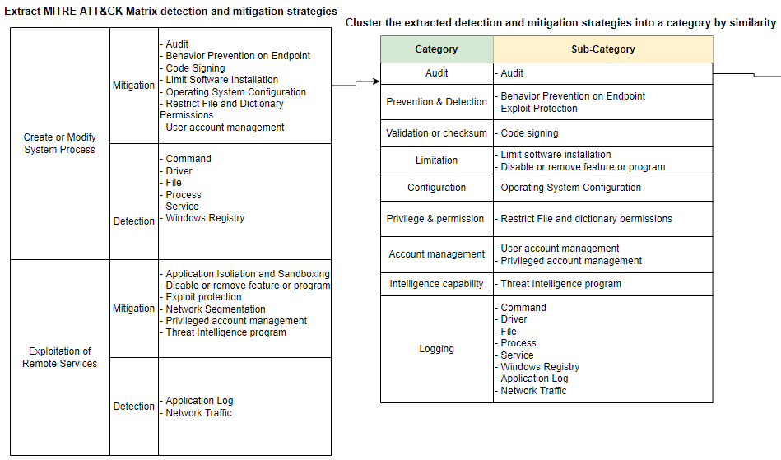
Demo

Slide 14
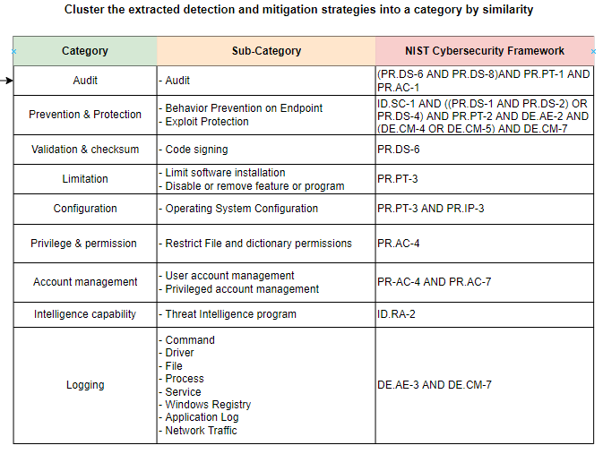
Demo

Slide 15
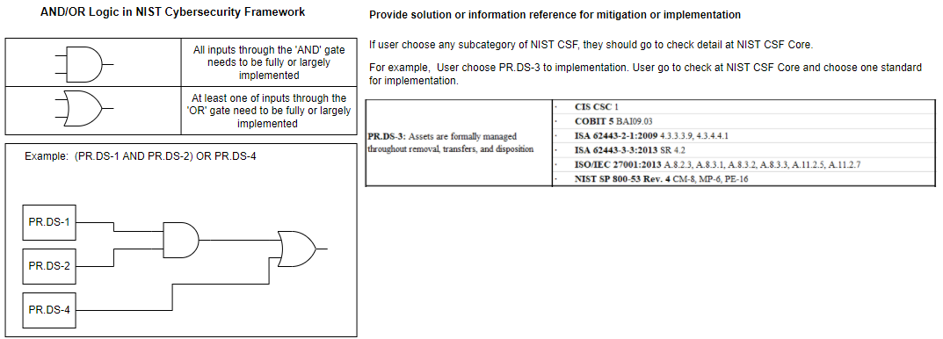
Demo

Slide 16
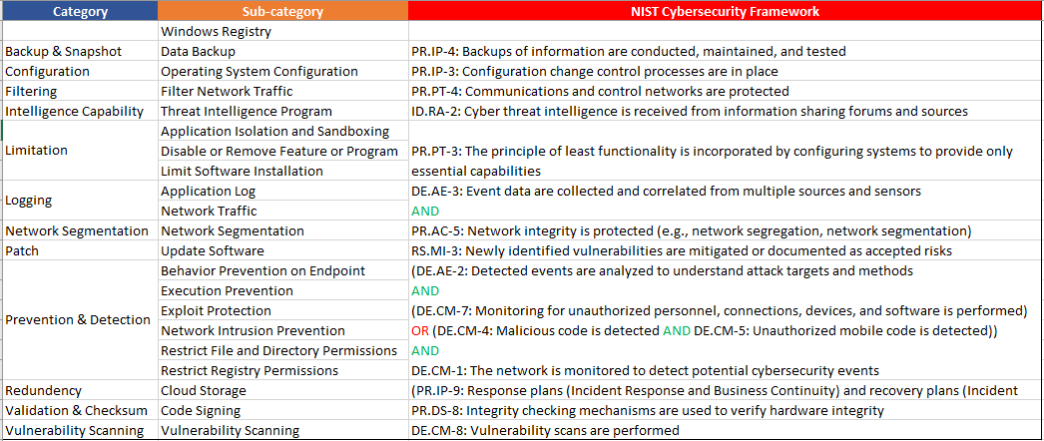
Demo

Slide 17
Future work
Maintained attack-defense framework
Threat defensive profile generator tool
Security control validation and measurement using Attack-defense framework

Slide 18
Reference
Why Do Ransomware Attacks Keep Happening? https://www.coresecurity.com/blog/why-do-ransomware-attacks-keep-happening
How to Use the MITRE ATT&CK Framework to Fight Ransomware Attacks https://www.cyberark.com/resources/blog/how-to-use-the-mitre-att-ck-framework-to-fight-ransomware-attacks
R. Kwon, T. Ashley, J. Castleberry, P. Mckenzie and S. N. Gupta Gourisetti, "Cyber Threat Dictionary Using MITRE ATT&CK Matrix and NIST Cybersecurity Framework Mapping," 2020 Resilience Week (RWS), 2020, pp. 106-112, doi: 10.1109/RWS50334.2020.9241271.
S. Boudko and H. Abie, "Adaptive Cybersecurity Framework for Healthcare Internet of Things," 2019 13th International Symposium on Medical Information and Communication Technology (ISMICT), 2019, pp. 1-6, doi: 10.1109/ISMICT.2019.8743905.
N. Teodoro, L. Gonçalves and C. Serrão, "NIST CyberSecurity Framework Compliance: A Generic Model for Dynamic Assessment and Predictive Requirements," 2015 IEEE Trustcom/BigDataSE/ISPA, 2015, pp. 418-425, doi: 10.1109/Trustcom.2015.402.
Barker, W., Scarfone, K., Fisher, W., & Souppaya, M. (2021). Cybersecurity Framework Profile for Ransomware Risk Management (No. NIST Internal or Interagency Report (NISTIR) 8374 (Draft)). National Institute of Standards and Technology.
Mesker, K., Engineer, I. C., & Chevron, E. T. C. (2014, October). Adapting NIST Cybersecurity Framework for Risk Assessment. In NIST Conference.

Slide 19
Thanks you…
Q & A

